Slide 1
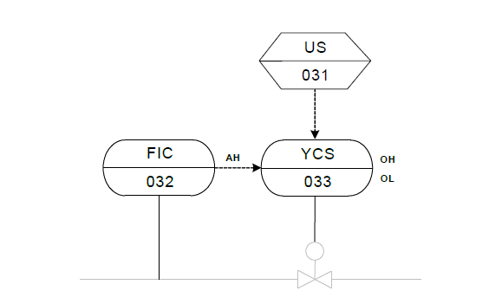
I06 Instrumentation example
Frei verwendbar

